Slide 1
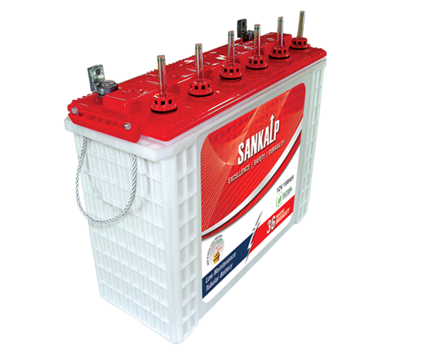
The Battery with a Pledge to Perform

Slide 2
Positive Spine Grid

Slide 3
High Pressure Die Casting

Slide 4
Tubular Bag For Positive

Slide 5
Precision Oxide Filling

Slide 6
Plate Pickling

Slide 7
Plate Lug Brushing

Slide 8
Negative Grid

Slide 9
Automatic Grid Casting

Slide 10
Programmable Paste Mixing

Slide 11
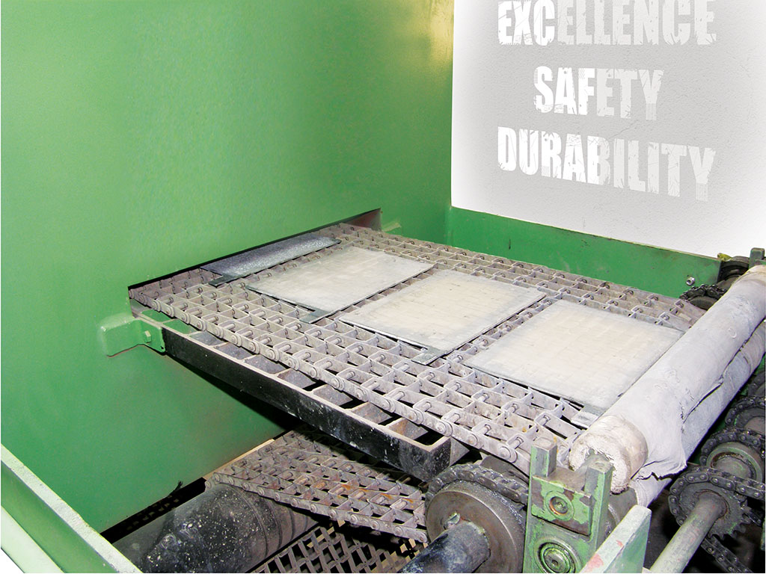
Flash Drying of Plates

Slide 12
Programmable Plate Curing Chamber

Slide 13
Envelope Separator

Slide 14
Element Straps

Slide 15
Terminal Pole

Slide 16
Terminal Take off Part

Slide 17
Sandwich Assembly for Group Burning

Slide 18
Sandwich Assembly for Group Burning

Slide 19
Sandwich Group Burning

Slide 20
Element Ready for Insertion

Slide 21
Container Hole Punching

Slide 22
Elements after Insertion in Container

Slide 23
Intercell Welding

Slide 24
Weld Strength Testing

Slide 25
Container – Lid Sealing

Slide 26
Container – Lid Sealing

Slide 27
Container – Lid Sealing

Slide 28
Container – Lid Sealing

Slide 29
Container – Lid Sealing

Slide 30
Terminal Building/Post Burning

Slide 31
Terminal Building

Slide 32
Pressure Testing

Slide 33
P4070168*

Slide 34
Battery Serial Number Engraving

Slide 35
P4070173*

Slide 36
Automatic Acid Filling

Slide 37
Battery Acid Filling-Check Sp. Gr. & Temperature

Slide 38
Battery Acid Filling-Check Sp. Gr. & Temperature

Slide 39
Battery Acid Filling-Check Sp. Gr. & Temperature

Slide 40
Formation

Slide 41
Programmable Battery Formation Facility

Slide 42
Batteries Ready For Packing

Slide 43
Finished Batteries

Slide 44
Safety Plugs

Slide 45
High Strength Handle

Slide 46
Coin Type Safety Plug

Slide 47
Component

Slide 48
LID container

Slide 49
Battery

Slide 50
Safe Guarding Against Pollution

Slide 51
Power House

Slide 52
Sankalp Workshop

Slide 53
Sankalp Team

Slide 54
Office: Gajanand Tower, No. 4/8, 3rd. Floor, 1st. Cross,
Annipura, SudhamNagar, K H Road, Bangalore - 560027
Phone : 080 22115936, Email: info@sankalpindia.in,
Web: sankalpindia.in
Factory: No. 16A, Bidadi Industrial Area, 2nd Phase, Sector I,
Bangalore-Mysore Road, Bidadi-562109
Regd. Off.: 18, Chandni Chowk Street, Kolkata - 700072
Ph: +91 9331117340
CIN No. - U31909WB2005PTC104164

